Slide 1
Outputs
PrintNet T

Slide 2
Context Schema
Workflow
&
Document
Design
Approval
(Proof)
Spool Production
Impositioning
Output
Notes:
If Impositioning modules are placed in the workflow, then it is necessary to have an Output module to terminate the workflow. Otherwise, Proof and Production are not possible.

Slide 3
Agenda
Introduction
Output Module
Data Output Module
Job Reporter Module
Sheet Statistic Module

Slide 4
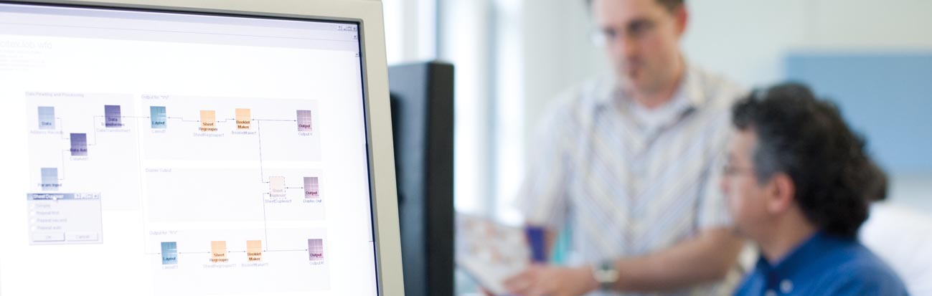
1. Introduction

Slide 5
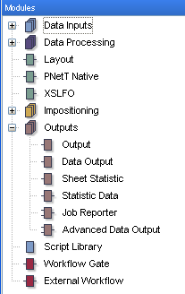
Introduction – Output Usage
Output, Data Output, and Sheet Statistic:
  Terminate workflow.
Statistic Data:
  Creates statistic data structure so it works as a data input for modules occurring behind it in the workflow.
  Job Reporter:
  Writes a specific report to the specified data file.
Notes:
Output, Data Output and Sheet Statistic
They terminate your workflow if Impositioning or through-flow output module is used.
When no Impositioning or through-flow output module is used, Layout and PNetTNative modules can also terminate a workflow.
Statistic Data
Creates a statistic data structure so it works as a data input for modules occurring behind it in the workflow.
Job Reporter
Writes a specific report to the specified data file.
It is one of the through-flow modules.

Slide 6
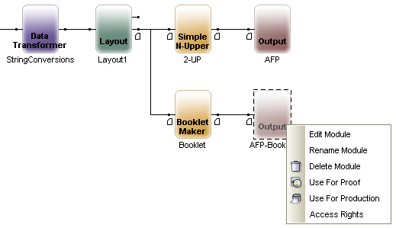
Output Selection
Layout, Output, Data Output, and Sheet Statistic modules can be selected as Outputs. Right-click in workflow to access selection context menu.

Slide 7
2. Output Module

Slide 8

Output Module – Purpose
Two major purposes of the module
Media size and properties definition:
  Impositioning module has been applied which demands definition of new output media size
  For different kinds of page sizes in Layout module
Assign Media to Driver:
  Assignment of Media size/properties definition to specific Driver configuration
Notes:
Impositioning – e.g., there is Simple N-Upper used: we need to position two A4 pages one beside another so it demands to define A3 output media size.
Assigning media to driver – e.g. A4 media needs to be assigned to input tray 0 and A3 media to input tray 1.

Slide 9
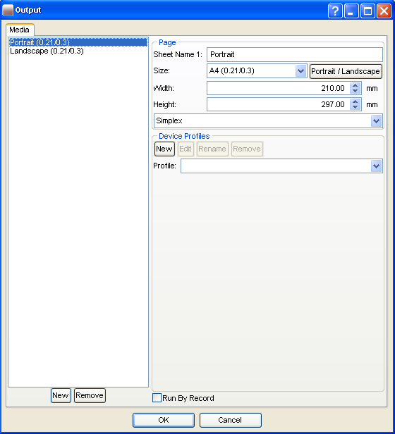
Media Size and Properties Definition
Media (Page) name corresponds with Layout Module Sheetname1.
Page size definition
Weight
Simplex/Duplex flag

Slide 10

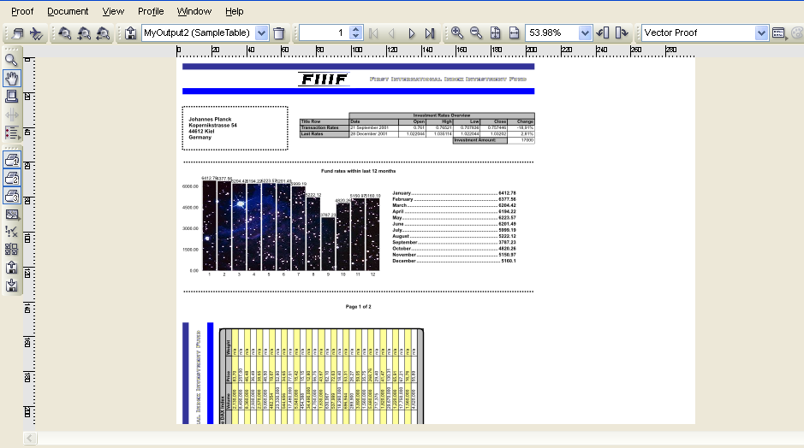
Undefined Media Size – Example
Notes:
Bottom of the page is cut out.
Reason: Bookletmaker module is used and there’s an undefined media size in Output module.

Slide 11
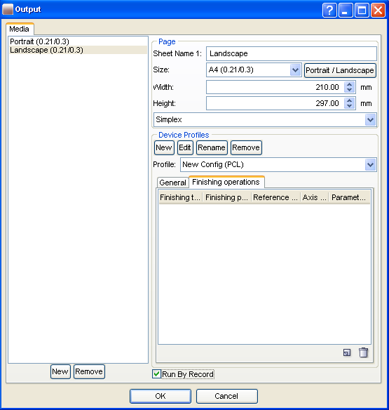
Assign Media to Driver
Device configuration
  Specific Output Device setting can be assigned to each Media definition.
  More information in specific Production Engine section.
Production preset
  “Run By Record” check box can be selected to be switched on by default in Production

Slide 12
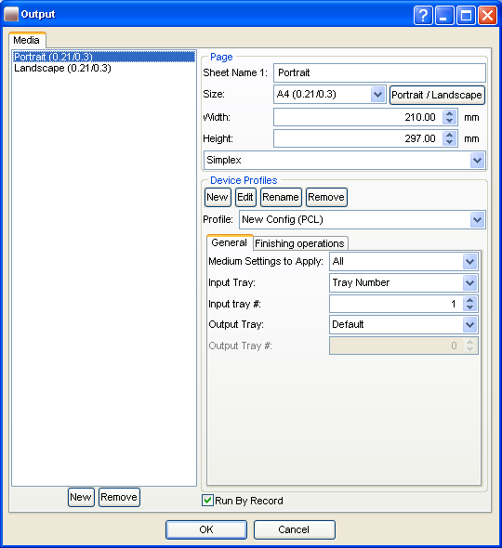
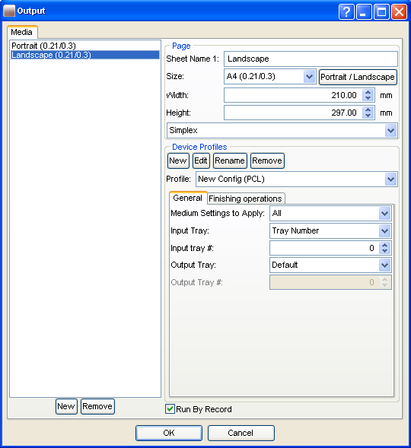
Assign Media to Driver – Example
Notes:
For “Portrait” media, Tray Number = 1 is assigned
For “Landscape” media, Tray Number = 0 is assigned

Slide 13

Output Module – Exercise
Define the media size for a job being printed with Simple N-Upper module applied.
  Open OutputExercise.wfd
  Insert a new Output module directly after the Simple N-Upper.
  Add a new media profile and configure the media size so that the job will print on the same printing sheet (3 across, 4 down – according to the settings in the Simple N-Upper module).
Notes:
See OutputExercise_done.wfd
Approximate Media size settings are:
Width – 500
Height – 410

Slide 14
3. Data Output Module

Slide 15
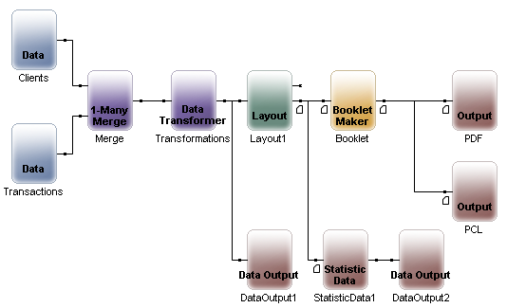
Data Output – Purpose
Workflow or its parts can be used for data manipulation and modification only. It results not in printed sheets but in another data file.
Possibilities:
  CSV
  Flat
  XML
  TSD
  PureFlat
  Null

Slide 16
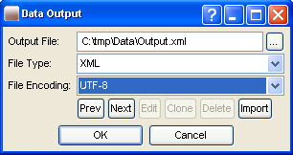

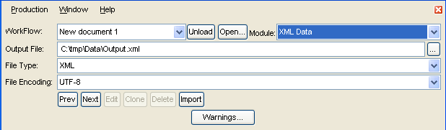
Data Output
Workflow
Double-click
Production
Notes:
Data Output module can be placed behind modules from section Data Inputs, Data Processing, or flow through Outputs.
Data Output properties can be modified as in Workflow as in Production environment.

Slide 17

Data Output – Exercise
Create two different Data Output files from the same workflow and compare the differences.
  Open DataOutputExercise.wfd
  Insert two Data Output modules; connect one behind the Data Input module and the other behind the Data Transformer module.
  Configure the Data Output modules so that they save the following .CSV files:
        C:\tmp\MyDataOutput1
        C:\tmp\MyDataOutput2
  Run production on both outputs and open the new files to compare the differences.
Open Data Transformer to see what has been done with the data.
Notes:
See DataOutputExercise_done.wfd for resolution.
The Data Transformer simply deletes some of the fields; the second Data Output file is basically a cropped version of the first one, with just string data, no numerical.

Slide 18
4. Job Reporter Module

Slide 19
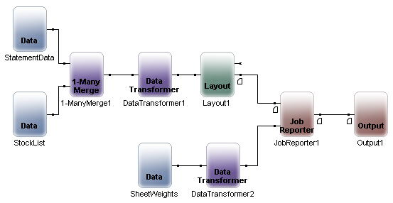
Job Reporter – Purpose
Calculates and reports total weight of sheets per group (record), sheet type, and job

Slide 20
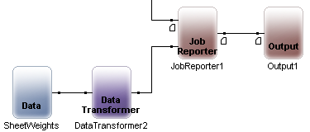
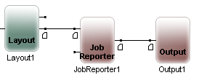
Job Reporter – How to Use It
There are two ways to set the page weights to be calculated:
  Via Input file to Job Reporter as in previous version
  Setting them in the properties of each Page
If both are set, then the weights from the Input file will be taken into consideration, because there are always some default settings in each Page node

Slide 21
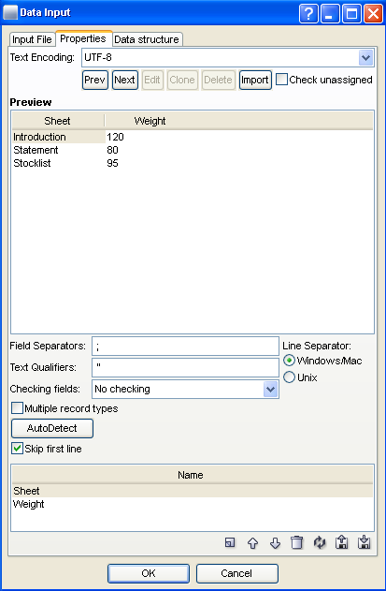
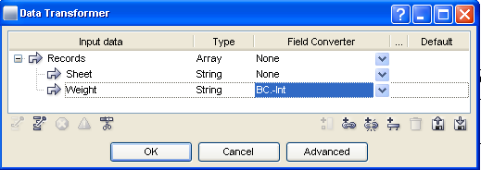
Job Reporter – Sheet Weights in Data File
Data Input
Data Transformer

Slide 22
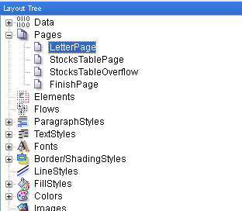
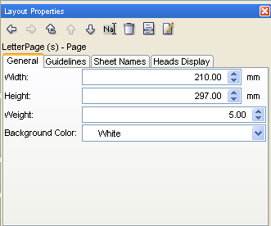
Sheet Weight in Page Layout Properties

Slide 23

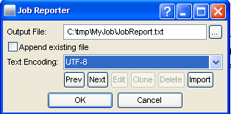
Job Reporter – Setup
Double-click

Slide 24
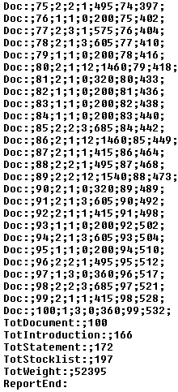
Job Reporter – Output File
  Doc: = it’s flag of “Doc:”record type for further Multiple record type definition.
  100 = group (100th record in our sample)
  1 = there is one page with sheetname “Introduction”
  3 = there is one page with sheetname “Statement”
  0 = there is one page with sheetname “Stocklist”
  360 = total weight of the group, 1*120+3*80+0*95
  99 = sheetname 3 is content of RecordIndex in our sample
  532 = sheetnames 4 is content of GlobalPageCounter in our sample

Slide 25
5. Sheet Statistic Module

Slide 26
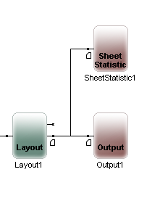
Sheet Statistic – Purpose
Creates a data file which contains the number of pages generated for each input data record.
This file is typically used to re-process the original data file into a postal rate optimized file.

Slide 27
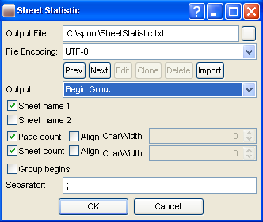
Sheet Statistic – Setup
  Place the module in the workflow directly after the Layout module for which you want to gather statistics.
  Double-click to open
  Define items to be logged, the separator type, and coding.

Slide 28
Sheet Statistic – Setup
The output file and path where logged items are to be saved.
Identifies whether statistics will be provided by group or all sheets.
Notes:
The character PrintNet T will use to divide fields in a CSV output log file.
If checked, information included for Sheet name 1.
If checked, information included for Sheet name 2.
When checked, a special field is added to the end of each line indicating whether the current sheet is the first sheet of the group (i.e., group begins with this sheet).
If checked, provides page counts.
If checked, provides sheet counts.

Slide 29
Sheet Statistic – Data File Example
  Delimiter is set to semi-colon
  First columns is sheet name 1
  Second column is the page count
  Third column is the sheet count
  The last column distinguishes between the first sheet of the group (when = 1) and other sheets (=0).
Introduction;1;5;1
Introduction;1;5;0
Statement;1;5;0
Statement;1;5;0
Stocklist;1;5;0
Introduction;1;11;1
Introduction;1;11;0

Slide 30
Sheet Statistic – Exercise
Create a .TXT file logging your sheet statistics from a job.
  Open SheetStatisticExercise.wfd
  Insert a Sheet Statistic module and connect it after Layout
  Configure the module to create the file C:\tmp\MySheetStatistic.txt; the file should have the following settings:
      Output = All Sheets
      Sheet name 1 and Sheet name 2 checked
      Page count checked
      Sheet count checked
  Run production on the Sheet Statistic module and open the new file
Make sure the proper output module is chosen in Production!

Slide 31

Output – Summary
In this presentation we have learned:
  About the Output, Data Output, Job Reporter, and Sheet Statistic modules.
  How to:
    Define media size in Output modules.
    Create a new file of data from your workflow using the Data Output module.
    Collect and report total weight of sheets per group (record) using the Job Reporter module.
    Create a file of statistic data from a job using the Sheet Statistic module.

Slide 32

Output – Discussion
How do you select a particular Output for use in Proof or Production?
What are the two main reasons that the Output Module is necessary?
Which of these four output modules (Output, Data Output, Job Reporter, or Sheet Statistic) do you think you need to use the most in the future? Why?
Notes:
1. How do you select a particular Output for use in Proof or Production?
Either right-click on the module in workflow, or select if from the combo-box directly in Proof or Production.
2. What are the two main reasons that the Output Module is necessary?
Resizing print sheets:
Impositioning module has been applied which demands definition of new output media size
For different kinds of page sizes in Layout module
Assign media to a particular driver.
3. Which of these four output modules (Output, Data Output, Job Reporter, or Sheet Statistic) do you think you need to use the most in the future? Why?

Slide 33

Thank You.
Do You Have Any Questions?

